Slide 1



Geographical Names Data Provision Service Progress in Lithuanian Spatial Data Portal
RITA VILIUVIENE, SE „GIS-CENTRAS“ r.viliuviene@gis-centras.lt
The 20th Meeting of the Baltic Division of the United Nations Group of Experts on Geographical names. Riga, 24-26 September, 2019

Slide 2

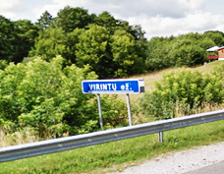
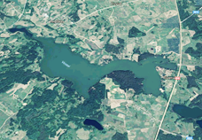
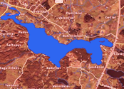
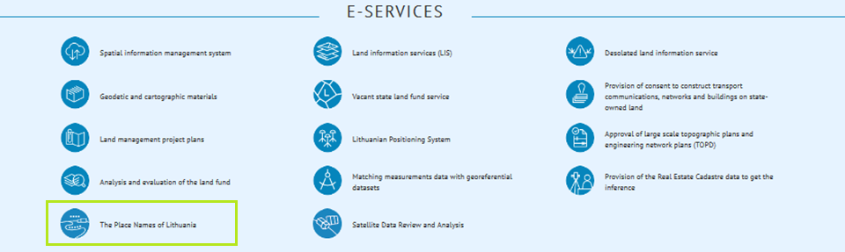
Content
Geographical names of the territory of Lithuania
Official spatial data set of geographical names
E-service for the management of the spatial data set
Involving of the community
Future plans

Slide 3
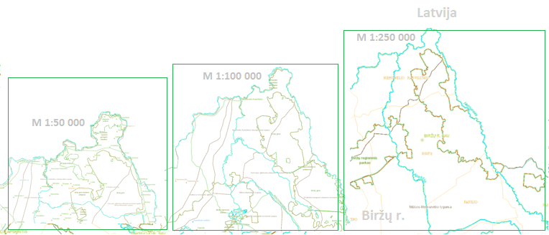
Spatial data set of geographical names for the territory of Lithuania GV_DR10LT – an official spatial data set
The data set and the framework for its maintenance as an electronic service is provided in Lithuanian spatial data portal
Access point of the e-service www.geoportal.lt/vietovardziai
Over 110 000 geographical names in spatial data set
GV_DRLT objects from different primary data sources: official and unofficial
Objects from primary data sources are transformed and introduced in the resulting GVD_RLT spatial data set

Slide 4
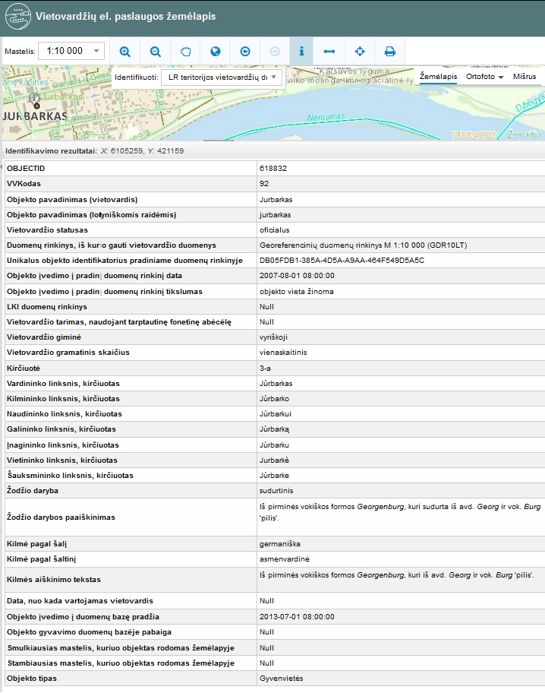
Attribute information of GV_DRLT objects
All geographical names are objects related to the location on map
GV_DRLT objects provide information linguistic information about GV_DRLT objects
Information about the status of geographical name
Object life cycle in the data base information
Object visual representation on the map

Slide 5
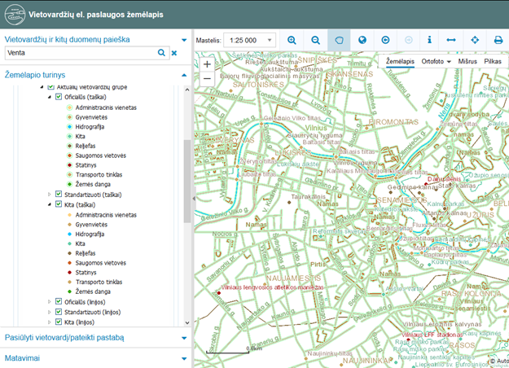
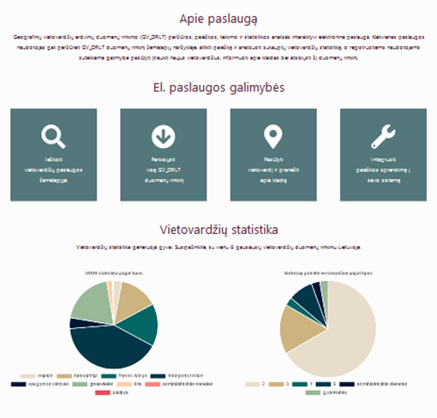
Geographical names e-service provision in national SDI portal
www.geoportal.lt/vietovardziai
The site and map viewer of e-service

Slide 6
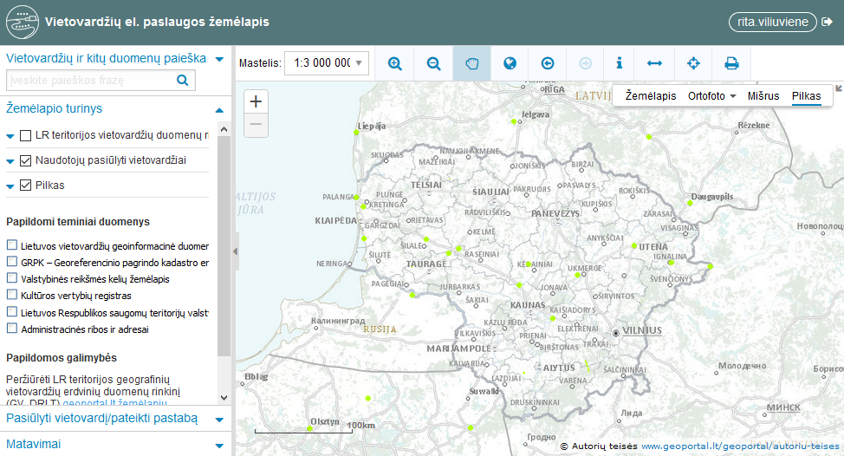
Public involvement in creating geographical names spatial data set
Deltuva | Karšuva | Upytė | Nalšia | Šiekštys (Žaliasiai) | Karalyčia | Sėla | Žiemgala | Kuršas Mėguva | Pilsotas | Lamata | Skalva | Gojus | Uolė | Geluža | Palenkė | Barta | Pagudė | Pamedė

Slide 7
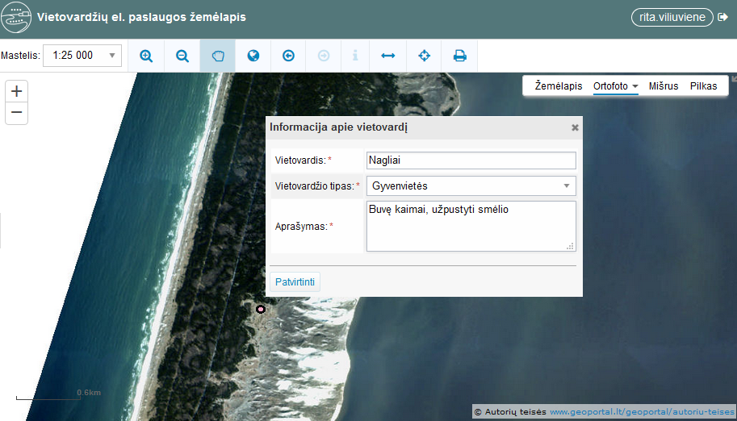
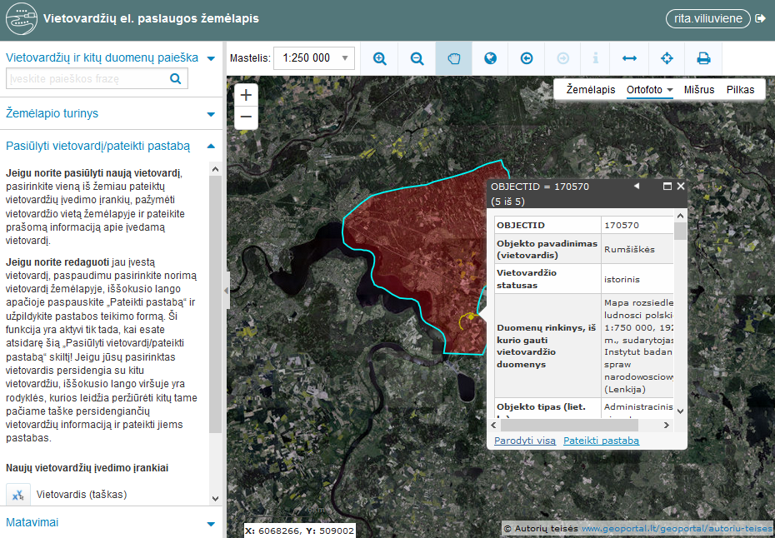
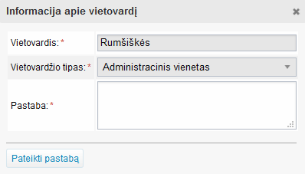
Public involvement in creating geographical names spatial data set
Using e-service users can add geographical names missing in GV_DRLT
Providing information about not correct geographical name is another possibility in the functionality of a e-service

Slide 8
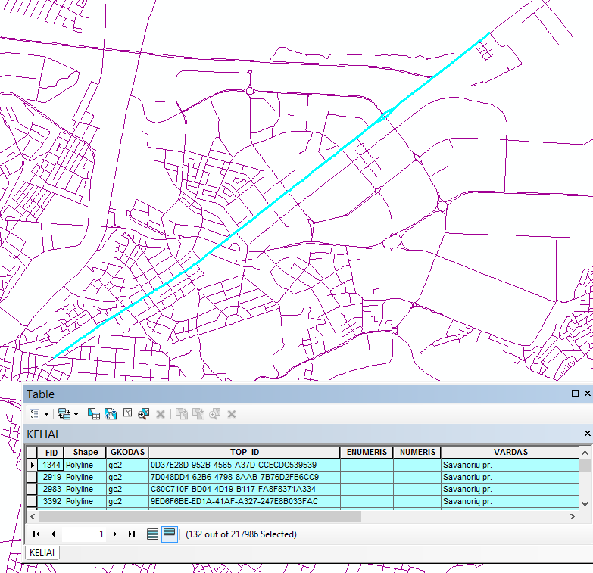
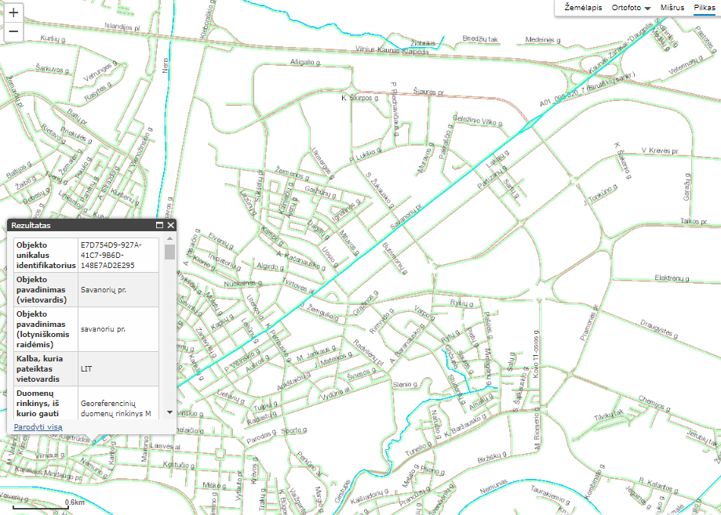
Geographical names spatial data set – automatically updated data set
Object transformation of the primary data sources were made in order to integrate geographical names objects into the resulted data set GV_DRLT
Street segments in the primary data source joined to appear one geometrical object in GV_DRLT
Objects with not accurate location in the primary data sources were located accurately in GV_DRLT
Objects from state registers and cadasters – have status “official” in GV_DRLT

Slide 9
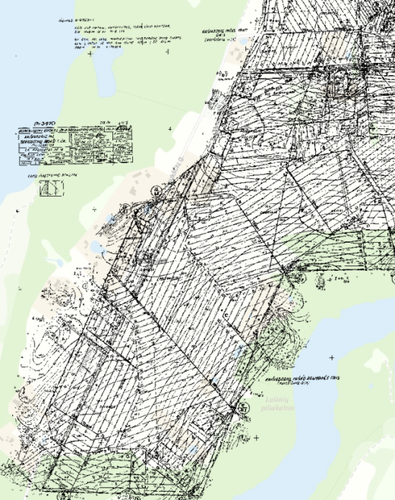
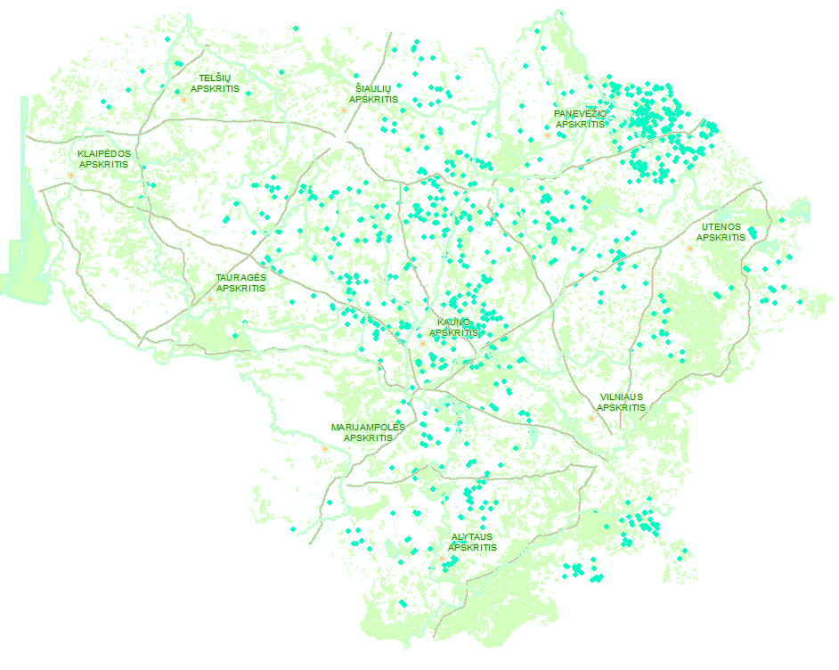
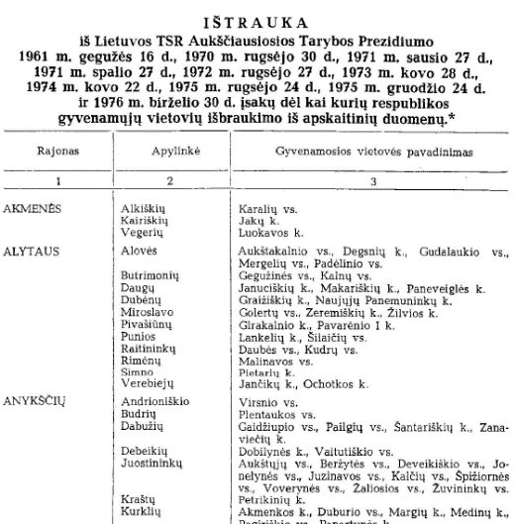
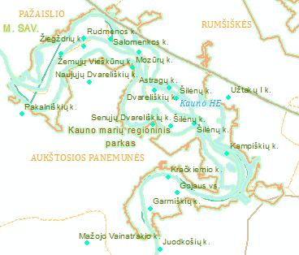

Geographical names spatial data set: a source for the analysis of historical settlements
The settlements disappeared cause of melioration, collectivization in the period of Soviet Union can be analyzed on map

Slide 10
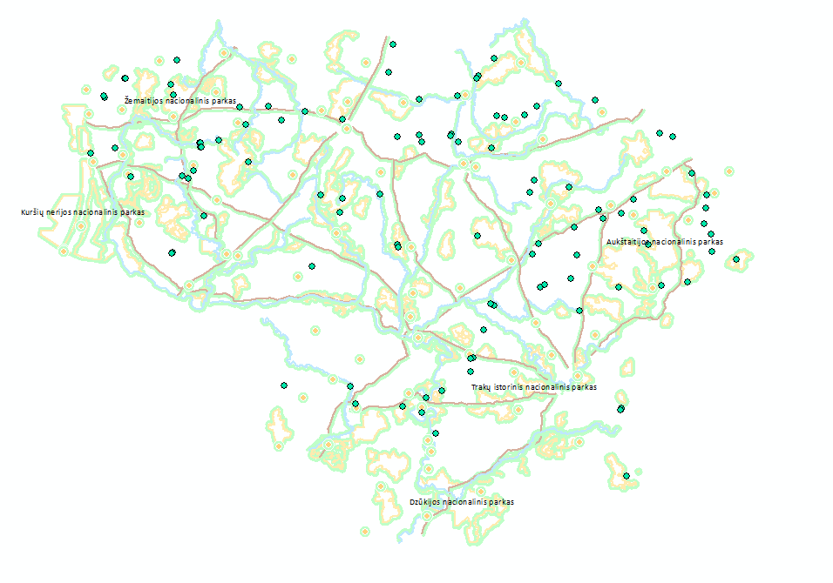
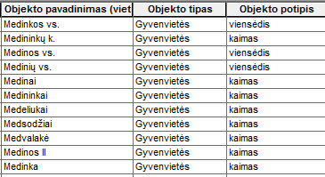
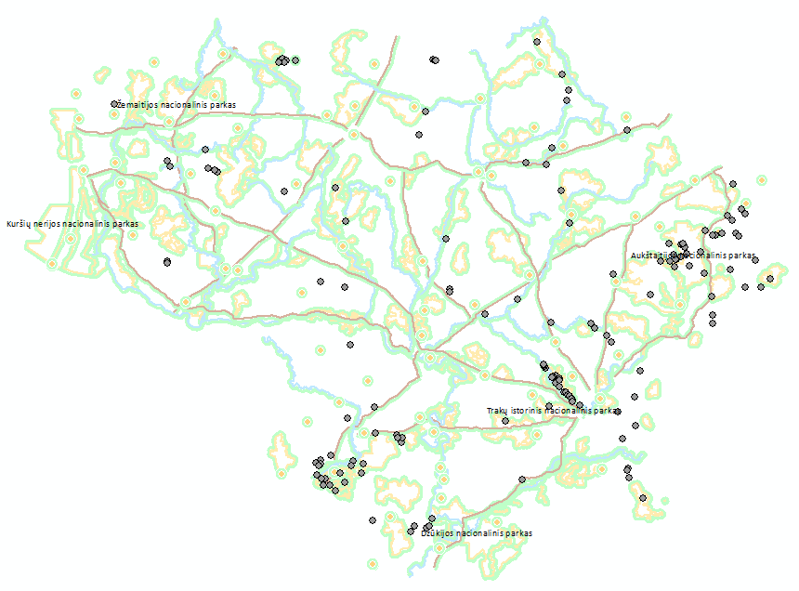
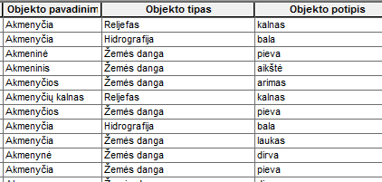
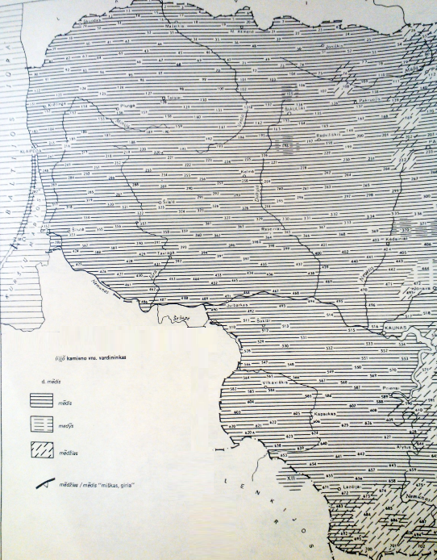
Geographical names spatial data set: a source for the geographic-linguistic analysis
Vietovardžiai pagal šaknį sietinų su žodžiu „medis“
Vietovardžiai pagal šaknį sietinų su žodžiu „akmuo“
possibility to distinguish geographical names of the settlements relation to the specifics of the territory and its surroundings

Slide 11
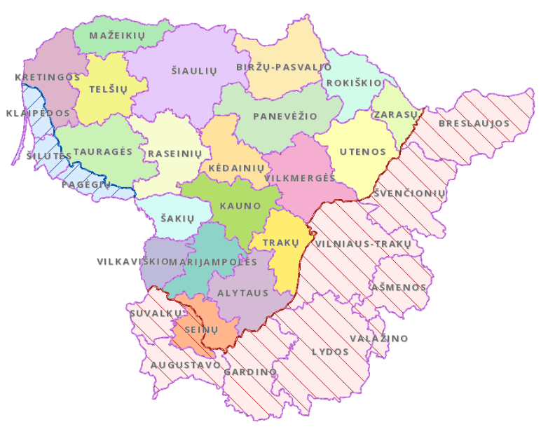
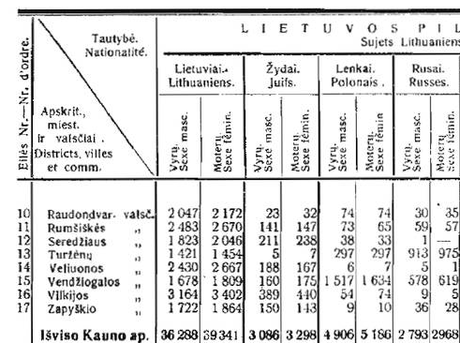
Geographical names spatial data set: a source for the historical-statistical analysis
Map of the first official population census in Lithuania in 1923 m.
Population census data were published in 1924 m. and 1925 m. in „Statistikos biuletenis”
Objects of territorial administration units of Lithuania in the beginning of XX century are provided in Geographical names spatial data source GV_DRLT and can be used for the historical statistical analysis using the results of the first population census in Lithuania

Slide 12
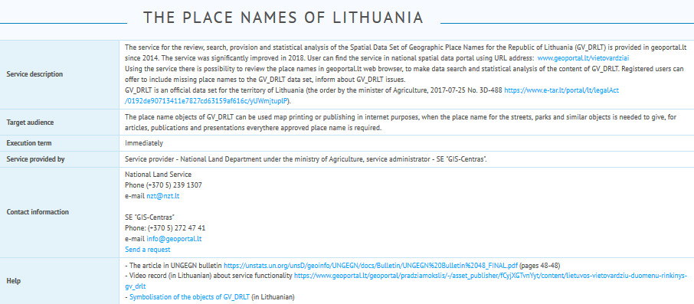
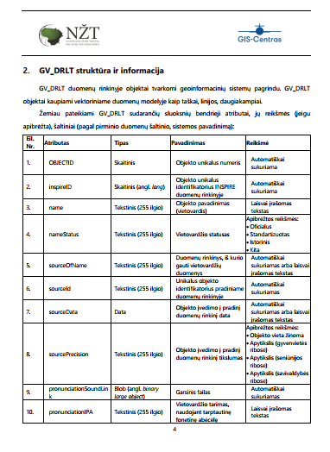
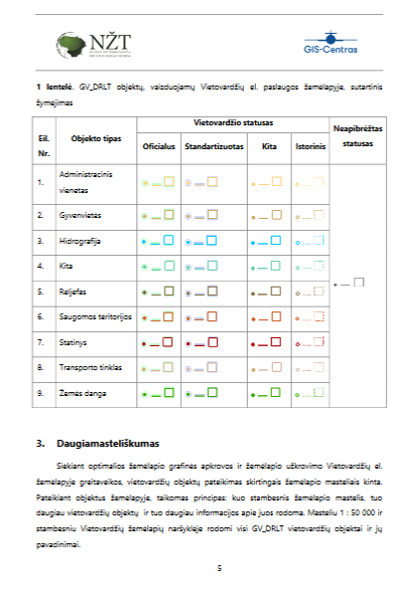
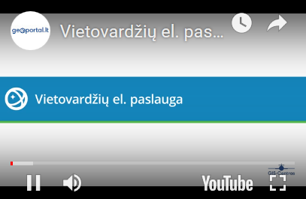
Help material for the usage of Geographical names e-service

Slide 13
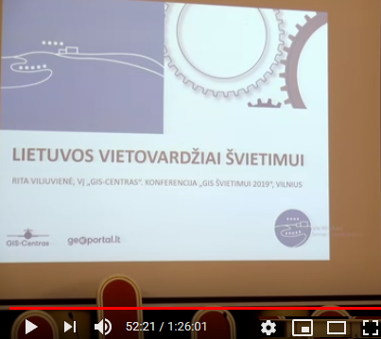

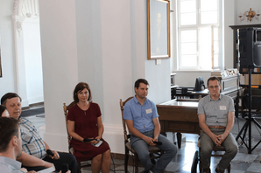
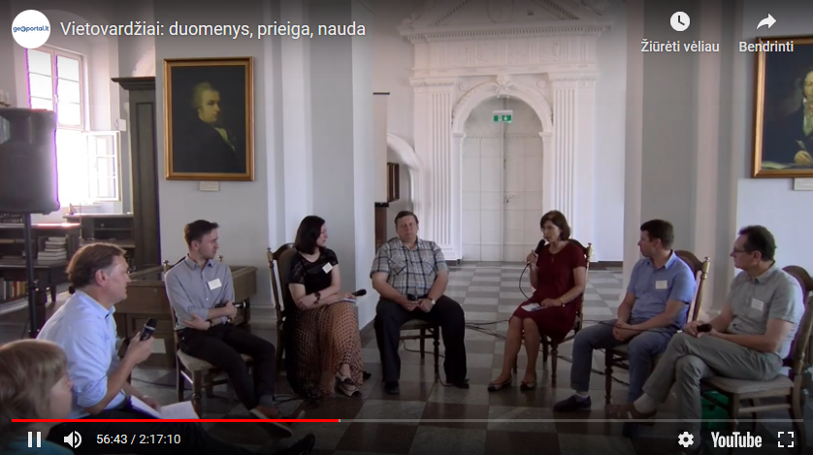


Public informing about the Geographical names e-service

Slide 14
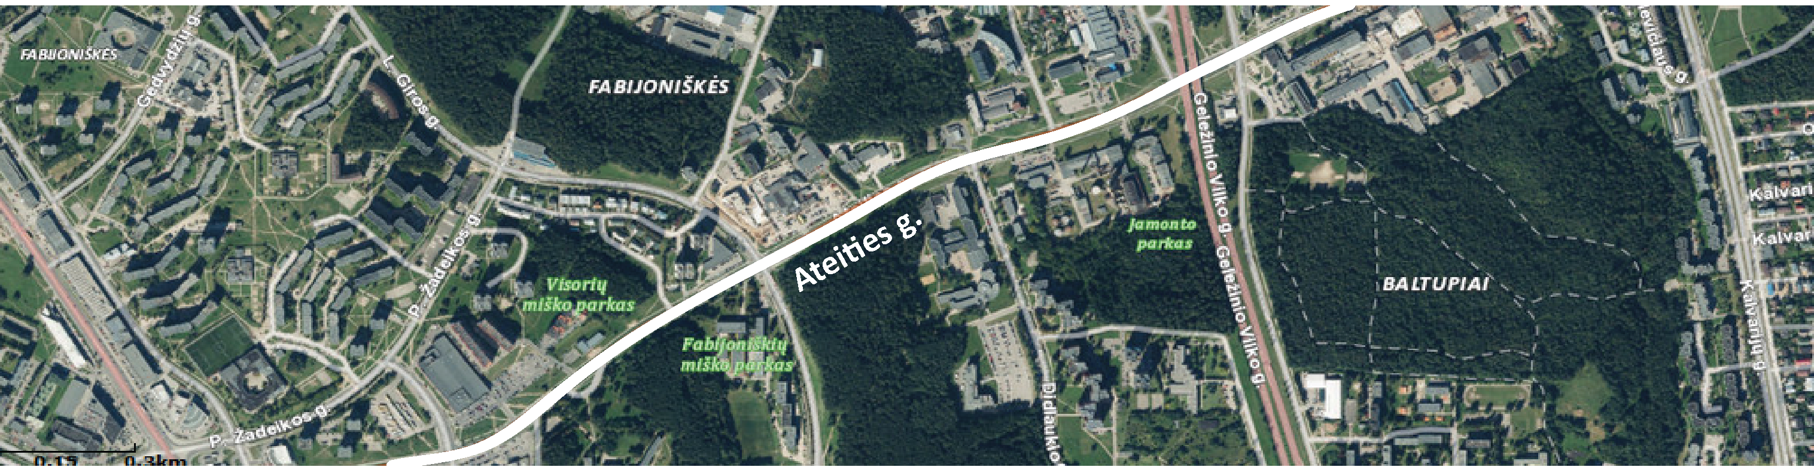
The value of Lithuanian geographical names e-service and future plans
The spatial data set GV_DRLT and e-service - the framework for maintenance of GV_DRLT - is important at national level for different groups of users. The main reasons are provided below:
Important information for place identification of people, property is provided in GV_DRLT spatial data set
Geographical names of GV_DRLT spatial data set can be used for creating new cartographic products, developing map based IT solutions and for update of existing cartographic material
GV_DRLT geographical names search service can be integrated into information systems
Geographical names spatial data set maintenance service provides possibility for territorial, linguistic analysis
GV_DRLT and related e-service needs for the support and improvement in future

Slide 15

Thank you for the attention! Questions? Comments?
Geographical Names Data Provision Service Progress in Lithuanian Spatial Data Portal
RITA VILIUVIENE, SE „GIS-CENTRAS“ r.viliuviene@gis-centras.lt

